Slide 1
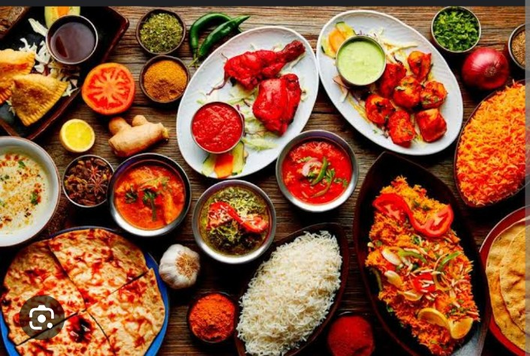
Title of the project: food recipes

Slide 2
AID BRANCH TEAM:-2 P.KRANTHI P.SANTOSHI CH.LIKITHA VANDANA B.HARSHITHA B.SWARUPA CH.D.V.V.R.SIVANI P.KALYANI SRI SATYA k.SPOORTHI SRI

Slide 3
INTRODUCTION OF FOOD RECIPE
1• Most cooks use recipes.
2.A recipe is a list of ingredients that gives you directions for preparing a specific food.
3.If you know how to follow recipes, then you will be successful in the kitchen. 15-2: 000 2

Slide 4
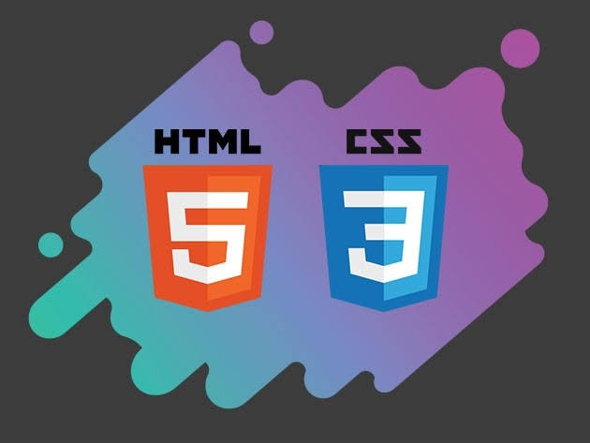
Programs used
1.HTML stands for hyper text markup language
2.It is used to create a web page
3.Html elements represented by tags
1.CSS stands for cascadling style sheets
2.It is used to controlling effects and flash animations

Slide 5


1.Food sharing recipes websites are fantastic for discovering diverse cuisines.
2.They offer a platform for food enthusiasts to share their fav recipes & cooking tips.
3.User can explore a wide range of recipes

Slide 6
Thank you
TEAM-2​ (AID)

